Slide 1
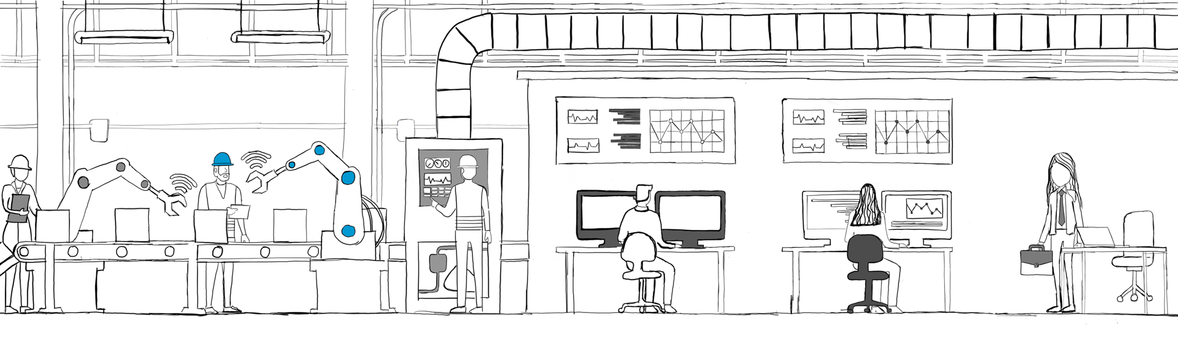

Process Engineer or CI Lead
Current Constraints
Future through MDP
Lacking a central source of truth about production due to siloed data
Unable to consistently see, let alone root-cause real-time and historical loss and downtime data
Stuck in reactive rather than proactive CI work
Leads problem-solving from a single, realtime source of truth for all production data
Uses MDP tools to proactively improve the line: loss trees, mass balance, correlation analysis, intelligent alerting
Dynamically optimizing production levers for any outcomes (“Cookbooks,” golden run engine)

